Slide 1
HotelApp
SOA Service Architecture
James Meyer – 2014-26-01

Slide 2
Objectives
  Provide ability of hotel receptionists to check in, check out, and view clients
  Provide best customer experience by always maximizing space between clients while never forcing existing clients to move
Notes
  This solution should function for hotels of any configuration (one, two, or three dimensions of varying sizes)
  No other factors are to be accounted for at first, only distance. Solution should be able to handle other factors in future updates, though
  No authorization needed, the assumption is this app is only installed on perfectly secured workstations that can only be accessed by authorized users

Slide 3
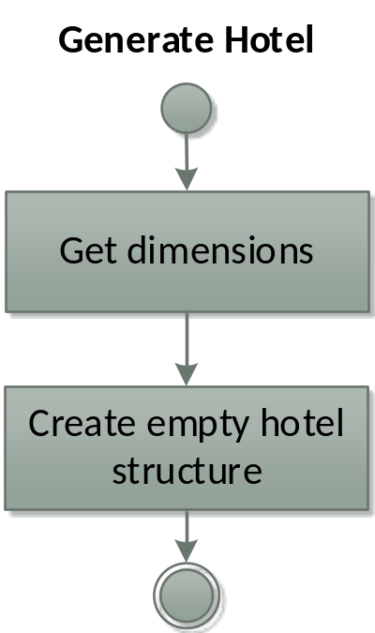
Use Case – Generate Hotel

Slide 4
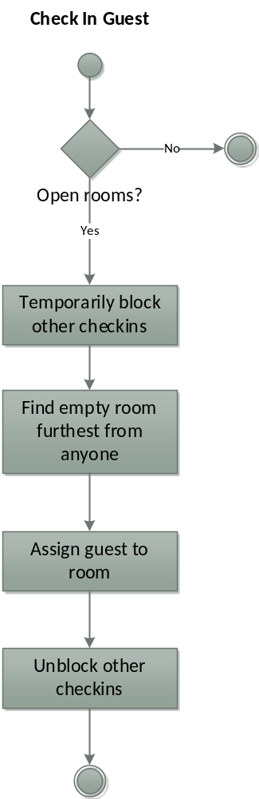
Use Case – Check In Guest

Slide 5
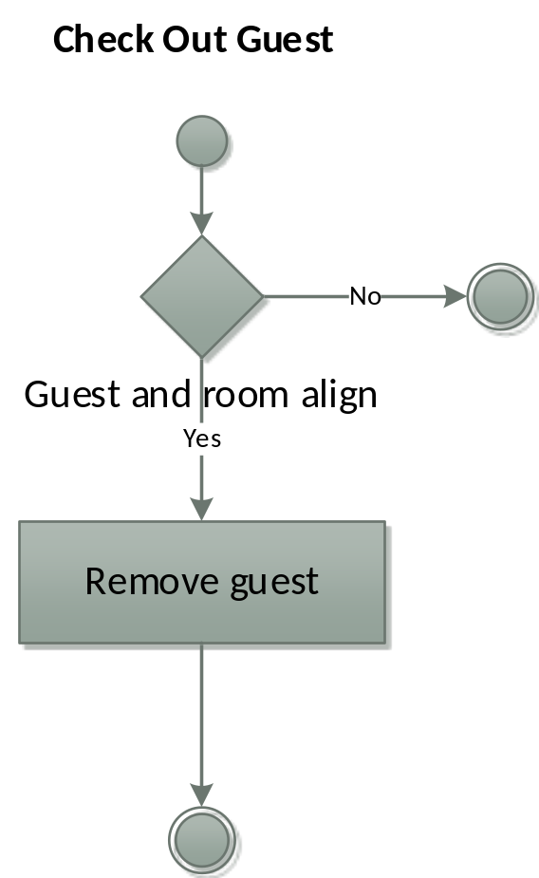
Use Case – Check Out Guest

Slide 6
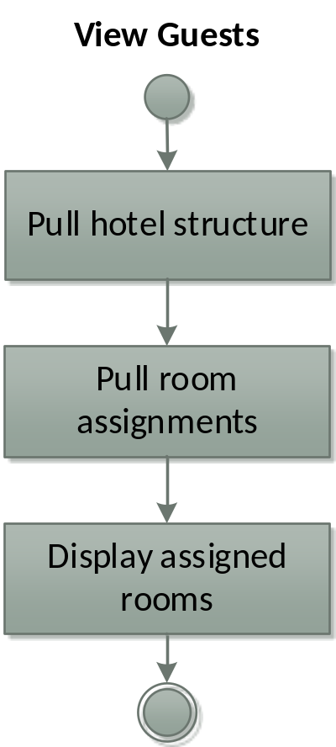
Use Case – View Guests

Slide 7
Architecture
Static Tiers View
Describes the list of components used and their logical tier breakdown/location

Slide 8
{Client}
Client
Hotel App
Utilities
{App Portal
Proxy}
Proxy
{Example
Manager}
Occupancy
Manager
{Demonstration
Engine}
Reserving
Engine
Business
Logic
{Resource1
Access}
Resource
Access
Room Access
{Res1 API}
{Utility
Service}
Resource

Slide 9
Call Chains
Describes the call chain of each core use case, ignoring sequence and repetition

Slide 10
Call Chain – Generate Hotel
Hotel App
Occupancy
Manager
Room Access

Slide 11
Call Chain – Check In Guest
Hotel App
Occupancy
Manager
Reserving
Engine
Room Access

Slide 12
Call Chain – Check Out Guest
Hotel App
Occupancy
Manager
Reserving
Engine
Room Access

Slide 13
Call Chain – View Guests
Hotel App
Occupancy
Manager
Room Access

Slide 14
Assemblies
Describes the assembly/binary allocation expected

Slide 15
Assembly Allocation
Hotel App
Executable (EXE)
Occupancy Manager.Contracts
Assembly (DLL)
Reserving Engine.Services
Library Assembly (DLL)
Occupancy Manager.Services
Assembly (DLL)
Reserving Engine.Contracts
Library Assembly (DLL)
Room Access.Contracts
Library Assembly (DLL)
Room Access.Services
Library Assembly (DLL)

Slide 16
WCF Services
Describes the portions of the architecture expected to be built as WCF services

Slide 17
WCF Services
Occupancy Manager.Contracts
Assembly (DLL)
Reserving Engine.Services
Library Assembly (DLL)
Occupancy Manager.Services
Assembly (DLL)
Reserving Engine.Contracts
Library Assembly (DLL)
Room Access.Contracts
Library Assembly (DLL)
Room Access.Services
Library Assembly (DLL)

Slide 18
Logical Services
Describes the logical appearance of the architecture – multiple services may work together to give the outward appearance of a single service. This view groups actual components together into the externally exposed logical services

Slide 19
Logical Services
Occupancy Manager.Contracts
Assembly (DLL)
Reserving Engine.Services
Library Assembly (DLL)
Occupancy Manager.Services
Assembly (DLL)
Reserving Engine.Contracts
Library Assembly (DLL)
Room Access.Contracts
Library Assembly (DLL)
Room Access.Services
Library Assembly (DLL)

Slide 20
Processes
Describes the process space expectations – components shown within the same process are expected to be literally in-proc

Slide 21
Process Boundaries
Hotel App
Executable (EXE)
Occupancy Manager.Contracts
Assembly (DLL)
Reserving Engine.Services
Library Assembly (DLL)
Occupancy Manager.Services
Assembly (DLL)
Reserving Engine.Contracts
Library Assembly (DLL)
Room Access.Contracts
Library Assembly (DLL)
Room Access.Services
Library Assembly (DLL)

Slide 22
Identities
Describes the identity sharing and delineation of the architectural components

Slide 23
Identities
Hotel App
Occupancy
Manager
Reserving
Engine
Room Access

Slide 24
Authentication
Describes the points at which authentication will take place for each core use case (2-way, so that both the consumer and provider are assured of the other’s identity)

Slide 25
Authentication– Generate Hotel
Hotel App
Occupancy
Manager
Room Access

Slide 26
Authentication – Check In Guest
Hotel App
Occupancy
Manager
Reserving
Engine
Room Access

Slide 27
Authentication – Check Out Guest
Hotel App
Occupancy
Manager
Reserving
Engine
Room Access

Slide 28
Authentication – View Guests
Hotel App
Occupancy
Manager
Room Access

Slide 29
Authorization
Describes the points of authorization within each core use case - where verification that the authenticated identity has the rights to perform a function is performed

Slide 30
Authorization – Generate Hotel
Hotel App
Occupancy
Manager
Room Access

Slide 31
Authorization – Check In Guest
Hotel App
Occupancy
Manager
Reserving
Engine
Room Access

Slide 32
Authorization – Check Out Guest
Hotel App
Occupancy
Manager
Reserving
Engine
Room Access

Slide 33
Authorization – View Guests
Hotel App
Occupancy
Manager
Room Access

Slide 34
Transactions
Describes the scope of transactions within each core use case – any unexpected error occuring within a transaction space should be completely reverted to the state of entry into that transaction space with no change to functional systems and a general failure reported outward.

Slide 35
Transactions– Generate Hotel
Hotel App
Occupancy
Manager
Room Access

Slide 36
Transactions– Check In Guest
Hotel App
Occupancy
Manager
Reserving
Engine
Room Access

Slide 37
Transactions– Check Out Guest
Hotel App
Occupancy
Manager
Reserving
Engine
Room Access

Slide 38
Transactions– View Guests
Hotel App
Occupancy
Manager
Room Access

Slide 39
Logical Threads
Describes the path of execution of each of the core use cases

Slide 40
Logical Thread– Generate Hotel
Hotel App
Occupancy
Manager
Room Access

Slide 41
Logical Thread– Check In Guest
Hotel App
Occupancy
Manager
Reserving
Engine
Room Access

Slide 42
Logical Thread– Check Out Guest
Hotel App
Occupancy
Manager
Reserving
Engine
Room Access

Slide 43
Logical Thread– View Guests
Hotel App
Occupancy
Manager
Room Access

